Slide 1

Objectives
In this session, you will learn to:
  Collect performance data for remote applications
  Analyze remote performance data using VTune

Slide 2
Collecting Performance Data for Remote Application
For a remote application, measuring the performance from a distant system is not an easy task.
VTune performance environment enables the users to:
  Collect performance data for remote applications
  Analyze the data using VTune tools, such as sampling and call graph analysis

Slide 3
Collecting Performance Data
For computers, memory space and processor speeds vary according to the applications and programs running on them.
It may not be possible to install software applications, such as VTune Performance Analyzer on some systems such as PDA and mobile phones.
By installing middleware software, called remote agents, you can collect and analyze performance data for these systems and devices.

Slide 4
Collecting Performance Data (Contd.)
The computer from which users collect remote data is called the remote agent system or the target system.
The computer on which users analyze the collected data is called the controlling system.

Slide 5
Collecting Performance Data (Contd.)
To collect remote data on a computer, you need to:
  Install VTune Performance Analyzer on the controlling system
  Restart the computer
You need to initiate remote data collection by performing the following steps:
  Enable the remote agent on the target system
  Enable DCOM (Distributed Component Object Model) components on the target system
  Enable the controlling system from which to collect remote performance data
  Specify the target system on which the remote application is running

Slide 6
Collecting Performance Data (Contd.)
Enabling the remote agent on the target system:
  The remote agent:
    Is a small set of files that include a subset of data collectors.
    Connects the computer from which the remote data is to be collected to the computer on which the collected data is to be analyzed.
  While enabling remote agent on the target system, you need to select the account(s) that you use to log into the controlling system(s).
  You need to reboot your system once the remote agent on the target system has been enabled.

Slide 7
Collecting Performance Data (Contd.)
Enabling DCOM Components on the target system:
  DCOM uses the Remote Procedure Call (RPC) mechanism to connect two computers.
  To collect remote data, you need to enable the following DCOM components on the target system:
    DbgExeCtrl
    StandardExeCtrl
    tebscollector

Slide 8
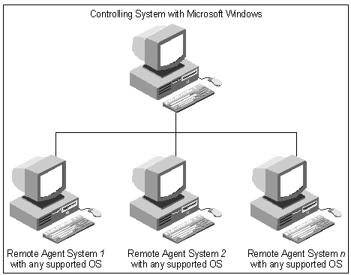
Collecting Performance Data (Contd.)
Enabling the Controlling System:
  The following figure shows how the controlling system is connected to target systems.

Slide 9
Collecting Performance Data (Contd.)
Enabling the Controlling System:
  You need to login as one of the users belonging to the account (group) specified while enabling the remote agent system on the controlling system.
  Run the remote agent configuration utility on the controlling system.

Slide 10
Collecting Performance Data (Contd.)
Specify the Remote Agent System:
  When the performance data of a remote agent system is collected for the first time, you need to add the IP address or the host name of that system to the list of existing systems.
  You can accomplish this by using one of the following formats:
    Microsoft Windows hostname
    Full domain name
    IP address

Slide 11
Just a minute
You want to test an application designed for a mobile phone but you cannot install VTune Performance Analyzer on the mobile phone. How will you analyze application performance?
Answer:
  You can use the Remote Data Collection feature of the VTune Performance Analyzer.

Slide 12
Analyzing Remote Performance Data Using VTune
After you have collected the performance data, you can use VTune™ Performance Environment to analyze data on remote agent systems.
You can analyze remote data on multiple remote agent systems, each running on a different operating system.

Slide 13
Analyzing Remote Performance Data Using VTune (Contd.)
You can analyze the performance data collected using VTune Performance Analyzer by using either:
  Sampling
  Call graph
  Sampling and call graph

Slide 14
Analyzing Remote Performance Data Using VTune (Contd.)
The prerequisites to analyze remote sampling and call graph analysis data are:
  Preparing remote agent systems
  Preparing the applications for which remote sampling on which sampling needs to be performed

Slide 15
Analyzing Remote Performance Data Using VTune (Contd.)
To view data collected remotely, you need to:
  Collect data on the remote system
  Transfer the data to the controlling machine
After collecting performance data for the remote application deployed on target systems, you can analyze the performance of the application on each system.

Slide 16
Summary
In this session, you learnt that:
  In remote data collection, the computer from where the data is collected is called the remote agent system or the target system.
  The computer on which the collected data is analyzed is called the controlling system.
  Using VTune Performance Analyzer, you can perform remote data collection on a number of remote agent systems, each running a different, supported operating system.
  The operating systems that are supported for remote data collection using VTune are Windows, Linux, and Windows CE.

Slide 17
Summary (Contd.)
  To initiate remote data collection, you need to:
    Enable the remote agent on the target system.
    Enable the controlling system on which to collect remote performance data.
    Specify the remote or target system on which the remote application is running.
    Create an activity on the controlling system for remote data collection.
  When the performance data of a remote agent system is collected for the first time, you need to add the IP address or the host name of that system to the list of existing systems. You can accomplish this by using one of the following formats:
    Microsoft Windows hostname
    Full domain name
    IP address

Slide 18
Summary (Contd.)
  To analyze remote sampling and call graph analysis data, the prerequisites are:
    Prepare the remote agent system on which the application is located.
    Prepare the additional applications required for remote data collection.
  To view data collected remotely, you need to collect data on the remote system and transfer the data to the controlling machine.

